Slide 1

`

Slide 2

ONLINE MART
SUBMITTED BY:
UNDER THE GUIDANCE OF-
1.SHYAMALA AKSHITHA
2.ANITHA KUSHA
3.ASMA AFREEN
POOJA MEHTHA

Slide 3
INTRODUCTION
Online Mart is web based application intended for online retailers.
Nowadays, one of the biggest transformations using technologies is the online shopping system.
It has almost the same size of the market as a general physical market possesses.
Customers can purchase items from comfort of their own homes or workplace.
In other words, the project aimed at creating a virtual shop environment for users, in some handy form, which will be available to them through the internet.

Slide 4
PROJECT OBJECTIVE
The main objective of this application is to make it interactive and its ease of use.
It also manage the details of Shopping, Internet, Payments, Bills, Customer.
Customers can also track their order status.

Slide 5
ONLINE MART BENEFITS
Convenience
Accessibility
Efficiency
Transactions
Time Saving
Saves Money
Multiple Varieties
Offers/Discounts
Online Tracking

Slide 6
TECHNOLOGIES USED
Java 1.8
Spring Boot 0.0.1+
Spring Framework 2.7.0+
Maven 4.0
Spring Data JPA(Hibernate)
MySQL
Postman
Validation

Slide 7
REQUIRED SPECIFICATIONS
HARDWARE CONFIGURATION | SOFTWARE CONFIGURATION
System : 64-bit Operating System | Software IDE : Spring Tool Suite
RAM : 4GB Hard Disk : 1TB | Language : Java
Operating System : Windows 10 | Back End : MySQL Server, Postman

Slide 8
SPRING ANNOTATIONS
@Entity : This annotation specifies that the class is an entity and is mapped to a database table.
@Table : The @Table annotation specifies the name of the database table to be used for mapping.
@Id : The @Id annotation specifies the primary key of an entity.
@Column : @Column annotation is used for adding the column the name in the table of a particular MySQL database.
@Autowired : The annotation @Autowired in spring boot is used to auto-wire a bean into another bean.
@Service : It is used to mark the class as a service provider. @Service annotation is used with classes that provide some business functionalities.

Slide 9
@Repository : This annotation is used to indicate that the class provides the mechanism for storage, retrieval, update, delete and search operation on objects.
@RestController : The @RestController is used at the class level and allows the class to handle the requests made by the client.
@RequestMapping : It is used to map the web requests. It has many optional elements like consumes, header, method, name, params, path, produces, and value. We use it with the class as well as the method.
@GetMapping : It is used to retrieve/fetch the data.
@PostMapping : It is used to create new resource.
@PutMapping : It is used to update/replace the data.
@DeleteMapping : It is used to delete the existing data.

Slide 10
VALIDATION ANNOTATIONS
@NotNULL : It determines that the value can’t be null.
@Min : It determines that the number must be equal or greater than the specified value.
@Max : It determines that the number must be equal or less than the specified value.
@Size : It determines that the size must be equal to the specified value.
@Pattern : It determines that the sequence follows the specified regular expression.

Slide 11
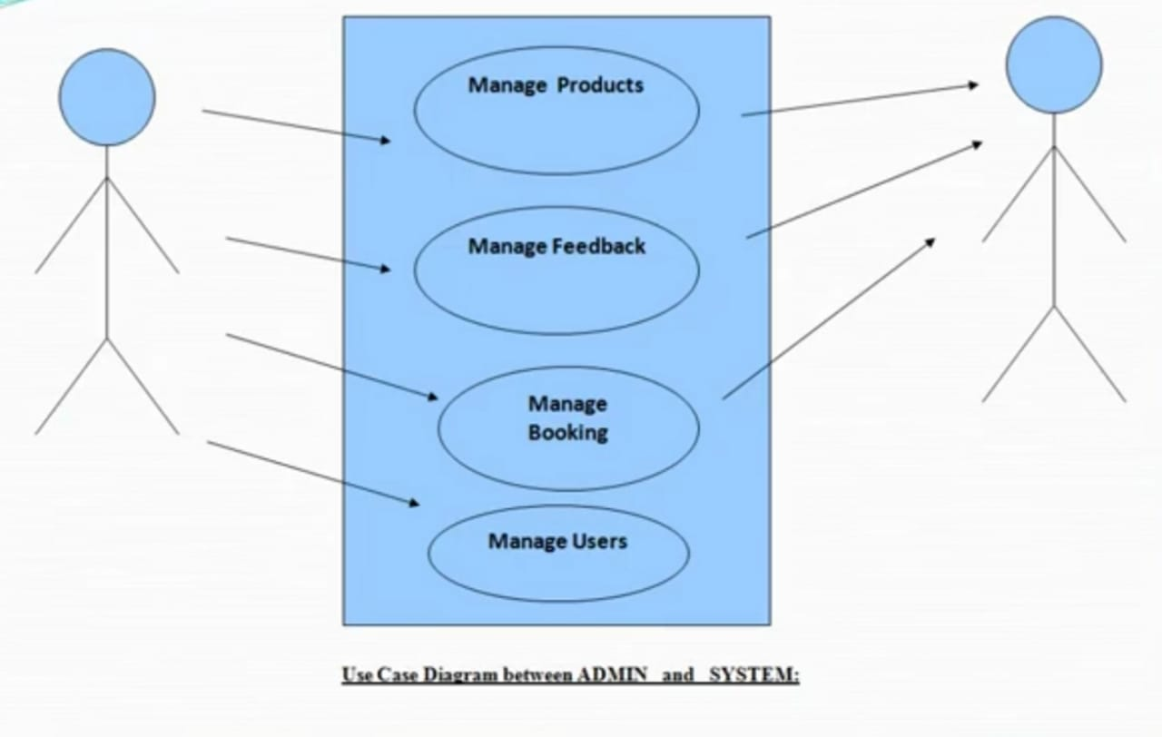
Use Case Diagram:
Use case diagram consists of use cases and actors and shows the interaction between them. The main purpose is to show the interaction between the use cases and the actor.

Slide 12
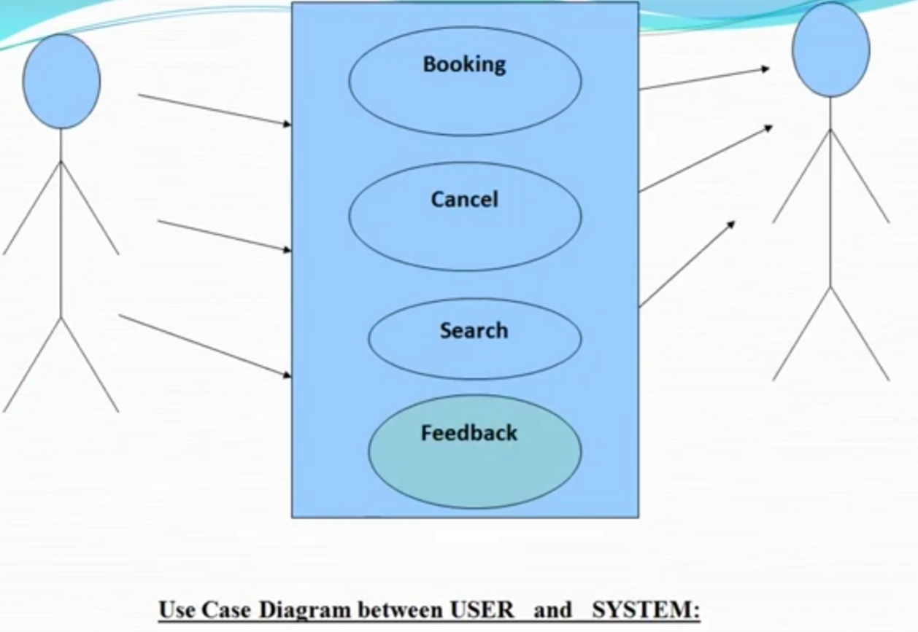

Slide 13
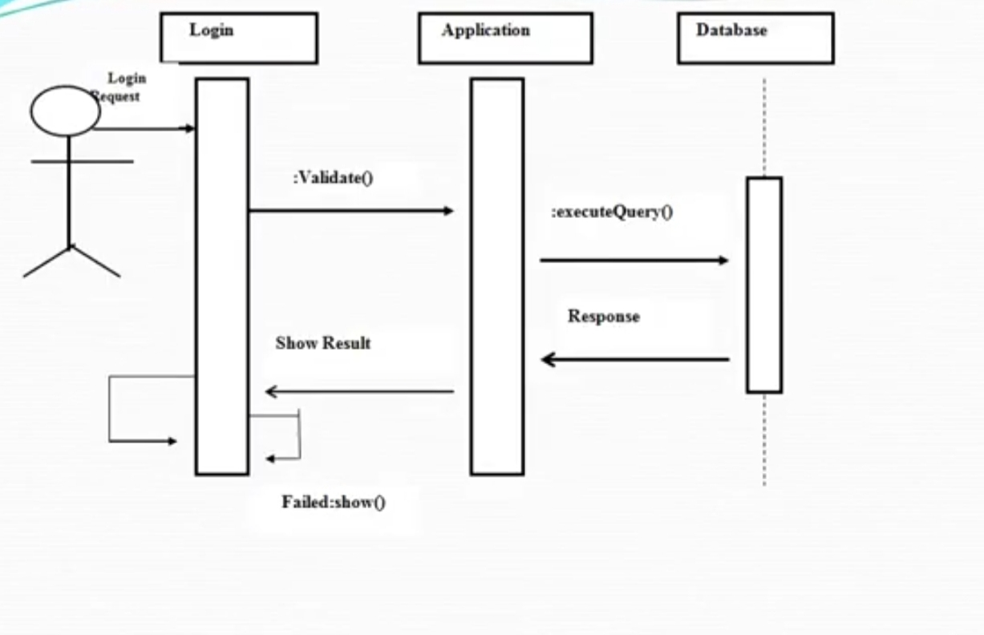
Sequence Diagram:
The purpose of sequence diagram is to show the flow of functionality through a use case. In other words, we call it a mapping process in terms of data transfers from the actor through the corresponding objects.

Slide 14
CONCLUSION
A shift from real time market to digital market
An online shopping allows people to shop online rather then going to an actual shopping centre.
Even though there are disadvantages and many advantages and ways to solve the disadvantages.

Slide 15
THANK YOU !

